Slide 1

SUPPLY CHAIN ANALYSIS
CDACL-003
Supply Chain Analysis
PRDA – 05

Slide 2


Process
1
Data Understanding
2
Data Cleaning
3
Data Modelling
4
Data Analysis
5
Uncover Insights

Slide 3
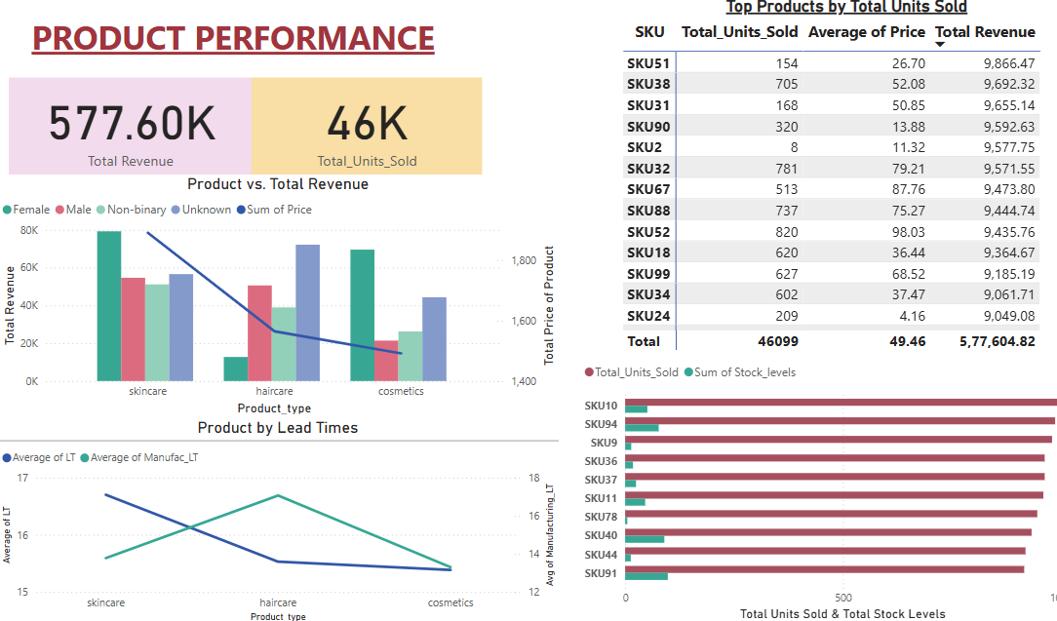

Slide 4
Product Performance
Key Insights
Recommendations
Skincare products lead in revenue and appeal broadly across all customer segments.
Haircare products have higher average pricing but longer manufacturing times.
Cosmetics show balanced demand, especially among non-binary and unknown customer groups.
Female customers drive the majority of product revenue.
Top-selling SKUs (e.g., SKU10, SKU94) contribute significantly to total units sold.
High-priced SKUs like SKU98 and SKU9 generate strong revenue despite lower volume.
Skincare has the highest lead time, indicating supply chain delay.
Cosmetics have the fastest overall production and delivery cycle.
Optimize skincare supply chain to reduce lead time and avoid bottlenecks.
Focus marketing efforts on female customers, the top revenue segment.
Promote high-margin SKUs (like SKU9, SKU98) using bundling or premium placement.
Improve haircare production efficiency to reduce long manufacturing delays.
Monitor inventory closely for fast-moving SKUs to avoid stockouts.
Explore targeted campaigns for cosmetics toward non-binary and emerging segments.

Slide 5
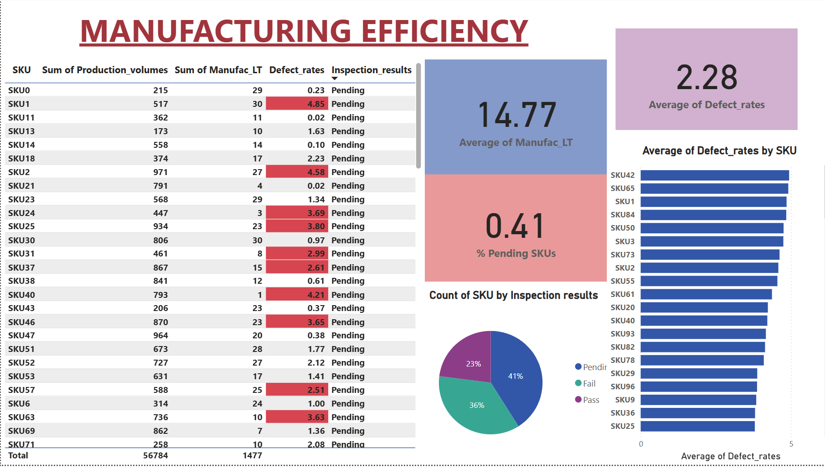

Slide 6
Manufacturing Efficiency
Key Insights
Recommendations
Some SKUs show high defect rates (e.g., SKUs with defect rates >2.5), affecting product quality.
Average Manufacturing Lead Time is 14.77 days, indicating moderate production turnaround.
Average Defect Rate is 2.28%, with SKU1 (4.85%), SKU2 (4.58%), and SKU40 (4.21%) showing the highest defect rates.
Over 41% of SKUs are still pending inspection, delaying final quality checks and approvals.
SKUs with high production volumes (like SKU25, SKU47, SKU46) tend to have lower defect rates, suggesting efficiency at scale.
Pie chart shows that only 23% of SKUs have passed inspection, a risk for shipment timelines and customer satisfaction.
Prioritize inspection of pending SKUs (especially those with high volumes and customer demand) to reduce bottlenecks.
Investigate high-defect SKUs like SKU1, SKU2, and SKU40 to find root causes — possibly material quality or process flaws.
Improve quality control checkpoints earlier in the production cycle to minimize rework and inspection delays.
Benchmark successful SKUs with low defect rates and apply best practices across production lines.
Automate or streamline inspections to improve the rate of pass/fail decisions and reduce idle stock.

Slide 7
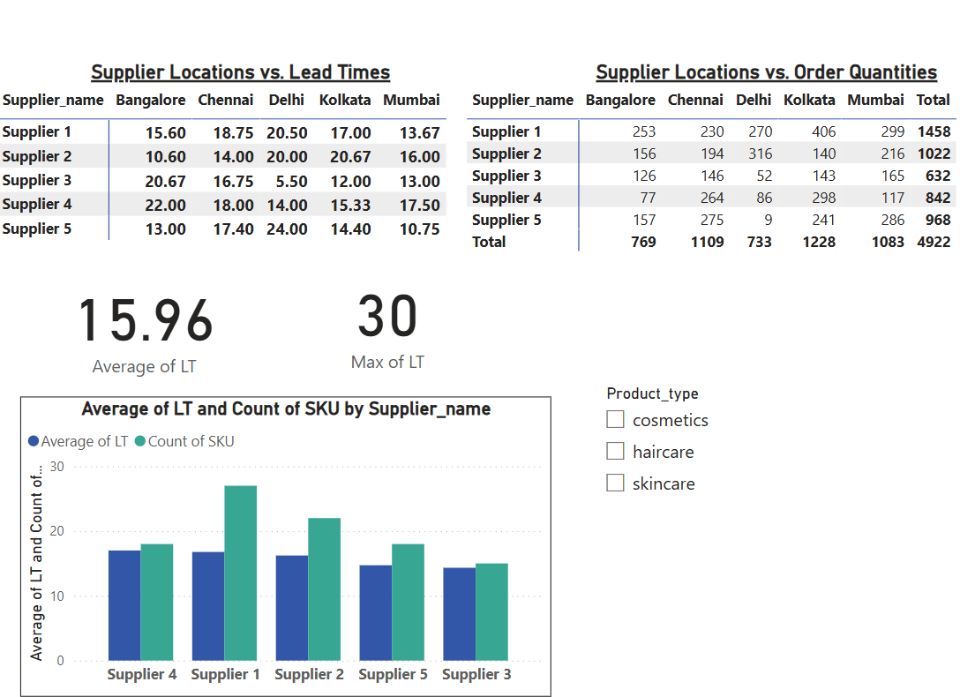
Supplier Performance & Lead Time Analysis
Key Insights
Lead times vary widely across suppliers and locations.
Supplier 3 (Delhi) and Supplier 5 (Mumbai) show relatively shorter lead times.
Supplier 5 (Delhi) and Supplier 4 (Bangalore) has longer lead times, which may impact responsiveness.
Supplier 2 and Supplier 5 show faster delivery times (as low as 10.6 and 10.75 days) with good order handling, making them operationally efficient.
Recommendations
Reallocate more orders to Supplier 2 and Supplier 5 to leverage their faster delivery and consistent performance.
Utilize Supplier 3 more in Delhi, where it shows exceptional lead time performance.
Set lead time thresholds (e.g., ≤18 days) and monitor suppliers exceeding them for potential re-evaluation.

Slide 8
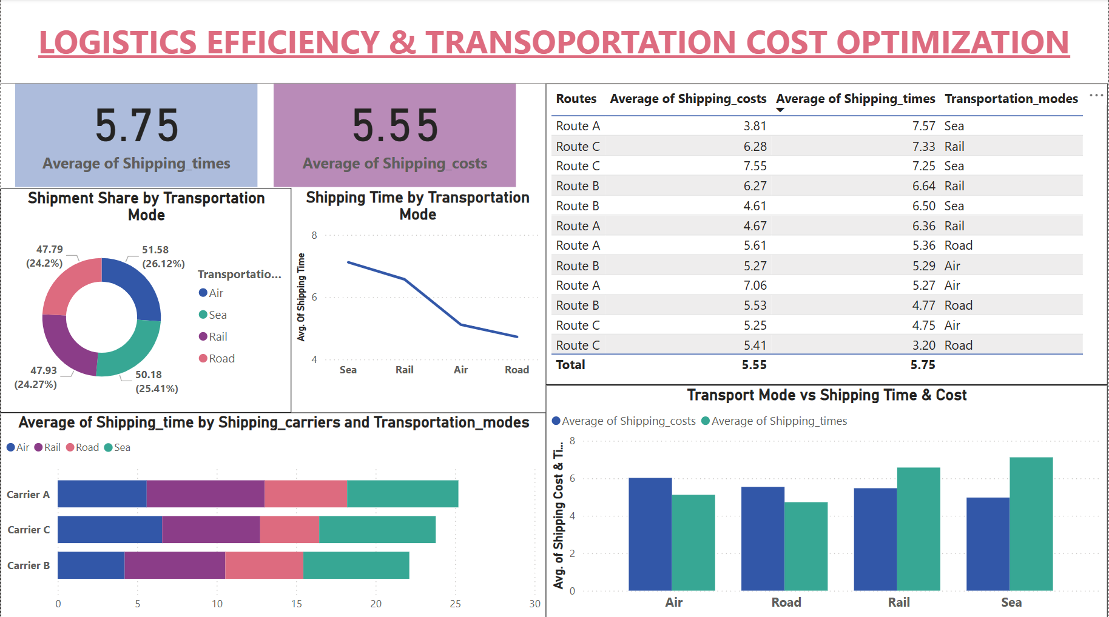

Slide 9
Logistic Efficiency & Transportation Cost Optimization
Key Insights
Recommendations
Road transport is delivering faster than air transport on average (4.72 vs 5.12 days). This suggests inefficiencies or delays in air logistics — possibly due to customs, consolidation, or scheduling.
Average shipping cost is 5.55 units, and average shipping time is 5.75 days across all transportation modes.
Road transport is the most time-efficient (3.2–4.7 days) and has lower costs compared to air and sea.
Sea transport is the slowest (7.5+ days on average) yet used significantly (25.4% share), indicating potential inefficiency.
Air transport offers balanced performance—moderate cost (~5.2) and time (~5.2 days), ideal for urgent shipments.
Shift more volume to road transport for shorter-distance or time-sensitive deliveries to reduce cost and lead time.
Reevaluate use of sea transport for non-essential shipments or renegotiate contracts to improve cost-effectiveness.
Optimize carrier selection by matching transport mode to performance—e.g., use Carrier B for routes requiring speed.

Slide 10

Thank you!
ANY QUESTIONS?

